Slide 1
Error Detection and Correction
Dr Sujit Das

Slide 2
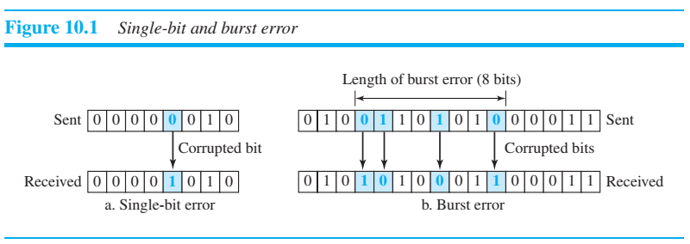
Types of Errors
The term single-bit error means that only 1 bit of a given data unit (such as a byte, character, or packet) is changed from 1 to 0 or from 0 to 1.
The term burst error means that 2 or more bits in the data unit have changed from 1 to 0 or from 0 to 1.
Figure 10.1 shows the effect of a single-bit and a burst error on a data unit.

Slide 3
A burst error is more likely to occur than a single-bit error
A burst error is more likely to occur than a single-bit error because the duration of the noise signal is normally longer than the duration of 1 bit, which means that when noise affects data, it affects a set of bits.
The number of bits affected depends on the data rate and duration of noise.
For example, if we are sending data at 1 kbps, a noise of 1/100 second can affect 10 bits;
if we are sending data at 1 Mbps, the same noise can affect 10,000 bits.

Slide 4
Redundancy
The central concept in detecting or correcting errors is redundancy.
To be able to detect or correct errors, we need to send some extra bits with our data.
These redundant bits are added by the sender and removed by the receiver.
Their presence allows the receiver to detect or correct corrupted bits.

Slide 5
Detection versus Correction
The correction of errors is more difficult than the detection.
In error detection, we are only looking to see if any error has occurred. The answer is a simple yes or no. We are not even interested in the number of corrupted bits.
A single-bit error is the same for us as a burst error.
In error correction, we need to know the exact number of bits that are corrupted and, more importantly, their location in the message.
The number of errors and the size of the message are important factors.
If we need to correct a single error in an 8-bit data unit, we need to consider eight possible error locations;
if we need to correct two errors in a data unit of the same size, we need to consider 28 (permutation of 8 by 2) possibilities. You can imagine the receiver’s difficulty in finding 10 errors in a data unit of 1000 bits.

Slide 6
Coding
Redundancy is achieved through various coding schemes. The sender adds redundant bits through a process that creates a relationship between the redundant bits and the actual data bits.
The receiver checks the relationships between the two sets of bits to detect errors. The ratio of redundant bits to data bits and the robustness of the process are important factors in any coding scheme.
We can divide coding schemes into two broad categories: block coding and convolution coding.
We will discuss bock coding

Slide 7
BLOCK CODING
In block coding, we divide our message into blocks, each of k bits, called datawords.
We add r redundant bits to each block to make the length n = k + r. The resulting n-bit blocks are called codewords.
How the extra r bits are chosen or calculated is something we will discuss later.
For the moment, it is important to know that we have a set of datawords, each of size k, and a set of codewords, each of size of n.
With k bits, we can create a combination of 2^{k} datawords; with n bits, we can create a combination of 2^{n} codewords.
Since n > k, the number of possible codewords is larger than the number of possible datawords.
The block coding process is one-to-one; the same dataword is always encoded as the same codeword.
This means that we have 2^{n} - 2^{k} codewords that are not used. We call these codewords invalid or illegal.
The trick in error detection is the existence of these invalid codes, as we discuss next. If the receiver receives an invalid codeword, this indicates that the data was corrupted during transmission.

Slide 8
Error Detection
How can errors be detected by using block coding? 1. The receiver has (or can find) a list of valid codewords. 2. The original codeword has changed to an invalid one.
The sender creates codewords out of datawords by using a generator that applies the rules and procedures of encoding (discussed later).
Each codeword sent to the receiver may change during transmission. If the received codeword is the same as one of the valid codewords, the word is accepted; the corresponding dataword is extracted for use.
If the received codeword is not valid, it is discarded. However, if the codeword is corrupted during transmission but the received word still matches a valid codeword, the error remains undetected.

Slide 9
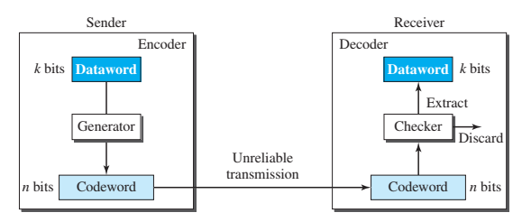
Process of error detection in block coding

Slide 10
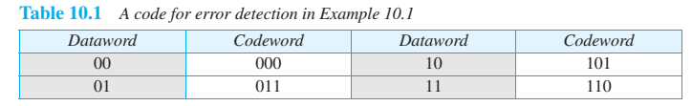
Example
Let us assume that k = 2 and n = 3. Table 10.1 shows the list of datawords and codewords. Later, we will see how to derive a codeword from a dataword
Assume the sender encodes the dataword 01 as 011 and sends it to the receiver. Consider the following cases:
1. The receiver receives 011. It is a valid codeword. The receiver extracts the dataword 01 from it
. 2. The codeword is corrupted during transmission, and 111 is received (the leftmost bit is corrupted). This is not a valid codeword and is discarded.
3. The codeword is corrupted during transmission, and 000 is received (the right two bits are corrupted). This is a valid codeword. The receiver incorrectly extracts the dataword 00. Two corrupted bits have made the error undetectable.

Slide 11
Hamming Distance
One of the central concepts in coding for error control is the idea of the Hamming distance.
The Hamming distance between two words (of the same size) is the number of differences between the corresponding bits.
We show the Hamming distance between two words x and y as d(x, y). We may wonder why Hamming distance is important for error detection.
The reason is that the Hamming distance between the received codeword and the sent codeword is the number of bits that are corrupted during transmission.
For example, if the codeword 00000 is sent and 01101 is received, 3 bits are in error and the Hamming distance between the two is d(00000, 01101) = 3.
In other words, if the Hamming distance between the sent and the received codeword is not zero, the codeword has been corrupted during transmission
The Hamming distance can easily be found if we apply the XOR operation (⊕) on the two words and count the number of 1s in the result.
Note that the Hamming distance is a value greater than or equal to zero.

Slide 12
Minimum Hamming Distance for Error Detection
In a set of codewords, the minimum Hamming distance is the smallest Hamming distance between all possible pairs of codewords.
Now let us find the minimum Hamming distance in a code if we want to be able to detect up to s errors.
If s errors occur during transmission, the Hamming distance between the sent codeword and received codeword is s.
If our system is to detect up to s errors, the minimum distance between the valid codes must be (s + 1), so that the received codeword does not match a valid codeword.
In other words, if the minimum distance between all valid codewords is (s + 1), the received codeword cannot be erroneously mistaken for another codeword.
Although a code with d_{min} = s + 1 may be able to detect more than s errors in some special cases, only s or fewer errors are guaranteed to be detected.
To guarantee the detection of up to s errors in all cases, the minimum Hamming distance in a block code must be d_{min} =s + 1.

Slide 13
Example
The minimum Hamming distance for our first code scheme (Table 10.1) is 2.
This code guarantees detection of only a single error.
For example, if the third codeword (101) is sent and one error occurs, the received codeword does not match any valid codeword.
If two errors occur, however, the received codeword may match a valid codeword and the errors are not detected.

Slide 14
Linear Block Codes
Almost all block codes used today belong to a subset of block codes called linear block codes.
The use of nonlinear block codes for error detection and correction is not as widespread because their structure makes theoretical analysis and implementation difficult.
We therefore concentrate on linear block codes.
For our purposes, a linear block code is a code in which the exclusive OR (addition modulo-2) of two valid codewords creates another valid codeword.
The code in Table 10.1 is a linear block code because the result of XORing any codeword with any other codeword is a valid codeword.
For example, the XORing of the second and third codewords creates the fourth one.

Slide 15
Minimum Distance for Linear Block Codes
It is simple to find the minimum Hamming distance for a linear block code. The minimum Hamming distance is the number of 1s in the nonzero valid codeword with the smallest number of 1s.
In our first code (Table 10.1), the numbers of 1s in the nonzero codewords are 2, 2, and 2.
So the minimum Hamming distance is d_{min} = 2.

Slide 16
Parity-Check Code
Perhaps the most familiar error-detecting code is the parity-check code.
This code is a linear block code. In this code, a k-bit dataword is changed to an n-bit codeword where n = k + 1.
The extra bit, called the parity bit, is selected to make the total number of 1s in the codeword even.
Although some implementations specify an odd number of 1s, we discuss the even case.
The minimum Hamming distance for this category is d_{min} = 2, which means that the code is a single-bit error-detecting code.
Our first code (Table 10.1) is a parity-check code (k = 2 and n = 3). The code in Table 10.2 is also a parity-check code with k = 4 and n = 5.

Slide 17
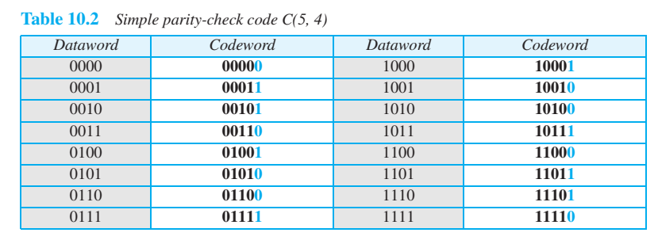
Simple parity-check code C(5, 4)

Slide 18
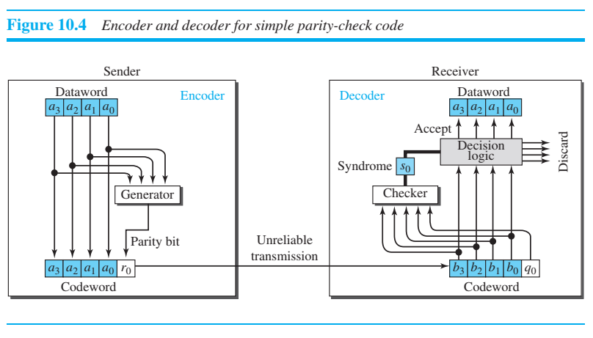
Encoder and decoder for simple parity-check code
Figure 10.4 shows a possible structure of an encoder (at the sender) and a decoder (at the receiver).

Slide 19
Encoder and decoder for simple parity-check code
The calculation is done in modular arithmetic. The encoder uses a generator that takes a copy of a 4-bit dataword (a0, a1, a2, and a3) and generates a parity bit r0.
The dataword bits and the parity bit create the 5-bit codeword.
The parity bit that is added makes the number of 1s in the codeword even.
This is normally done by adding the 4 bits of the dataword (modulo-2); the result is the parity bit. In other words,
r0 = a3 + a2 + a1 + a0 (modulo-2)
If the number of 1s is even, the result is 0; if the number of 1s is odd, the result is 1. In both cases, the total number of 1s in the codeword is even.
The sender sends the codeword, which may be corrupted during transmission.
The receiver receives a 5-bit word. The checker at the receiver does the same thing as the generator in the sender with one exception: The addition is done over all 5 bits. The result, which is called the syndrome, is just 1 bit.
s0 = b3 + b2 + b1 + b0 + q0 (modulo-2)
The syndrome is 0 when the number of 1s in the received codeword is even; otherwise, it is 1.
The syndrome is passed to the decision logic analyzer.
If the syndrome is 0, there is no detectable error in the received codeword; the data portion of the received codeword is accepted as the dataword;
if the syndrome is 1, the data portion of the received codeword is discarded. The dataword is not created

Slide 20
CYCLIC CODES
Cyclic codes are special linear block codes with one extra property.
In a cyclic code, if a codeword is cyclically shifted (rotated), the result is another codeword.
For example, if 1011000 is a codeword and we cyclically left-shift, then 0110001 is also a codeword.
In this case, if we call the bits in the first word a0 to a6, and the bits in the second word b0 to b6, we can shift the bits by using the following:
b1 = a0 b2 = a1 b3 = a2 b4 = a3 b5 = a4 b6 = a5 b0 = a6
In the rightmost equation, the last bit of the first word is wrapped around and becomes the first bit of the second word

Slide 21
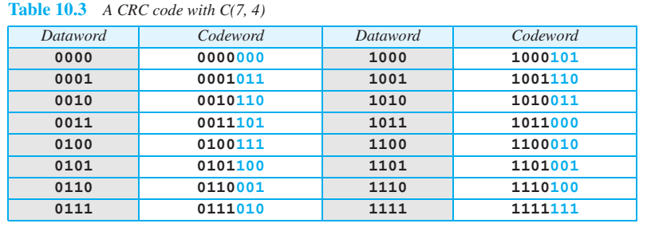
CRC

Slide 22
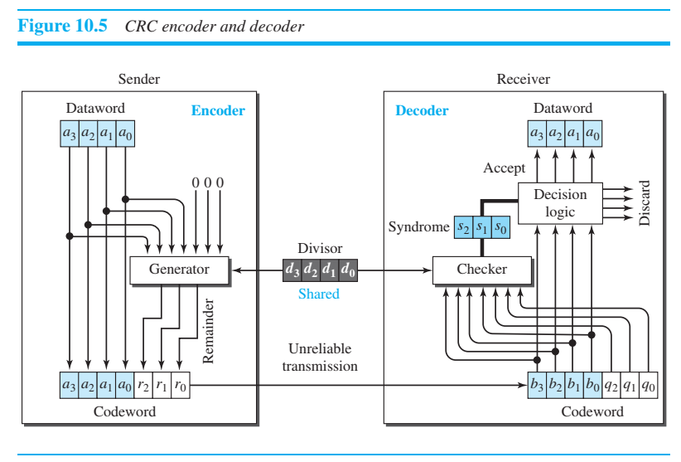
CRC

Slide 23
CRC
In the encoder, the dataword has k bits (4 here); the codeword has n bits (7 here).
The size of the dataword is augmented by adding n - k (3 here) 0s to the right-hand side of the word.
The n-bit result is fed into the generator. The generator uses a divisor of size n - k + 1 (4 here), predefined and agreed upon.
The generator divides the augmented dataword by the divisor (modulo-2 division).
The quotient of the division is discarded; the remainder is appended to the dataword to create the codeword.

Slide 24
CRC
The decoder receives the codeword (possibly corrupted in transition).
A copy of all n bits is fed to the checker, which is a replica of the generator.
The remainder produced by the checker is a syndrome of n - k (3 here) bits, which is fed to the decision logic analyzer.
The analyzer has a simple function.
If the syndrome bits are all 0s, the 4 leftmost bits of the codeword are accepted as the dataword (interpreted as no error); otherwise, the 4 bits are discarded (error).

Slide 25
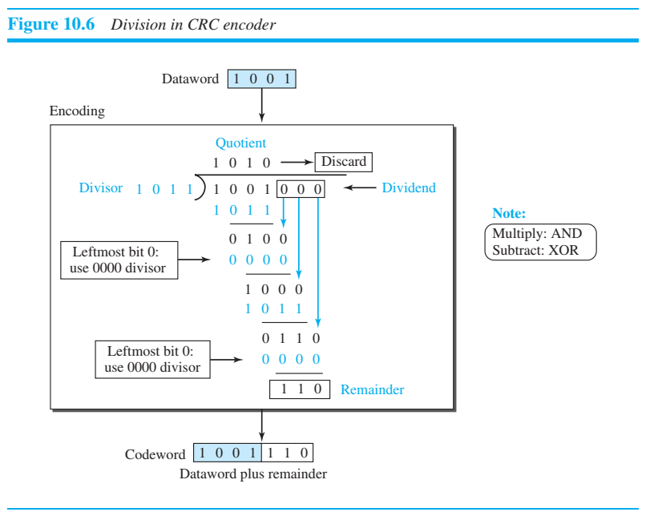
Division in CRC encoder

Slide 26
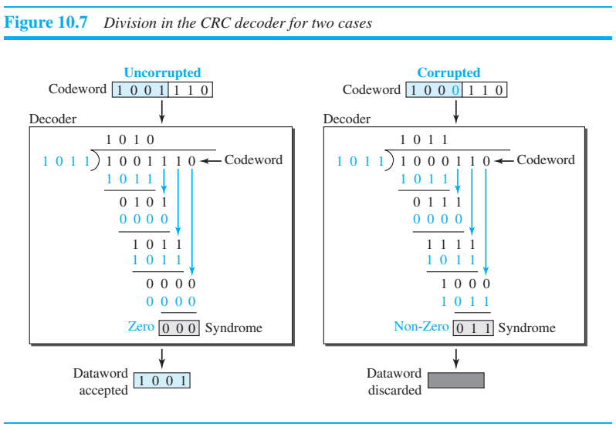
Division in the CRC decoder for two cases

Slide 27
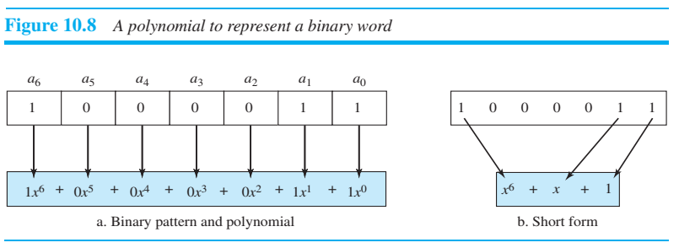
Polynomials
A better way to understand cyclic codes and how they can be analyzed is to represent them as polynomials.
A pattern of 0s and 1s can be represented as a polynomial with coefficients of 0 and 1.
The power of each term shows the position of the bit; the coefficient shows the value of the bit.
Figure 10.8 shows a binary pattern and its polynomial representation. In Figure 10.8a we show how to translate a binary pattern into a polynomial;
in Figure 10.8b we show how the polynomial can be shortened by removing all terms with zero coefficients and replacing x1 by x and x0 by 1.
Figure 10.8 shows one immediate benefit; a 7-bit pattern can be replaced by three terms. The benefit is even more conspicuous when we have a polynomial such as x²³ + x³ + 1. Here the bit pattern is 24 bits in length (three 1s and twenty-one 0s) while the polynomial is just three terms

Slide 28
Polynomials
Degree of a Polynomial
The degree of a polynomial is the highest power in the polynomial. For example, the degree of the polynomial x⁶ + x + 1 is 6.
Note that the degree of a polynomial is 1 less than the number of bits in the pattern. The bit pattern in this case has 7 bits.
Adding and Subtracting Polynomials
Adding and subtracting polynomials in mathematics are done by adding or subtracting the coefficients of terms with the same power. In our case, the coefficients are only 0 and 1, and adding is in modulo-2.
This has two consequences. First, addition and subtraction are the same.
Second, adding or subtracting is done by combining terms and deleting pairs of identical terms
For example, adding x⁵ + x⁴ + x² and x⁶ + x⁴ + x² gives just x⁶ + x⁵.
The terms x⁴ and x² are deleted. However, note that if we add, for example, three polynomials and we get x² three times, we delete a pair of them and keep the third.

Slide 29
Polynomial
Multiplying or Dividing Terms
In this arithmetic, multiplying a term by another term is very simple; we just add the powers.
For example, x³ × x⁴ is x⁷. For dividing, we just subtract the power of the second term from the power of the first. For example, x⁵/x² is x³.
Multiplying Two Polynomials
Multiplying a polynomial by another is done term by term.
Each term of the first polynomial must be multiplied by all terms of the second. The result, of course, is then simplified, and pairs of equal terms are deleted. The following is an example:

Slide 30
Shifting
A binary pattern is often shifted a number of bits to the right or left.
Shifting to the left means adding extra 0s as rightmost bits;
shifting to the right means deleting some rightmost bits.
Shifting to the left is accomplished by multiplying each term of the polynomial by x^{m}, where m is the number of shifted bits;
shifting to the right is accomplished by dividing each term of the polynomial by x^{m}. The following shows shifting to the left and to the right.

Slide 31
Cyclic Code Encoder Using Polynomials
Now that we have discussed operations on polynomials, we show the creation of a codeword from a dataword.
Figure 10.9 is the polynomial version of Figure 10.6. We can see that the process is shorter.
The dataword 1001 is represented as x³ + 1. The divisor 1011 is represented as x³ + x + 1.
To find the augmented dataword, we have left-shifted the dataword 3 bits (multiplying by x³). The result is x⁶ + x³.
Division is straightforward. We divide the first term of the dividend, x⁶, by the first term of the divisor, x³.
The first term of the quotient is then x⁶/x³, or ^{x3}. Then we multiply x³ by the divisor and subtract (according to our previous definition of subtraction) the result from the dividend.
The result is x⁴, with a degree greater than the divisor’s degree; we continue to divide until the degree of the remainder is less than the degree of the divisor

Slide 32
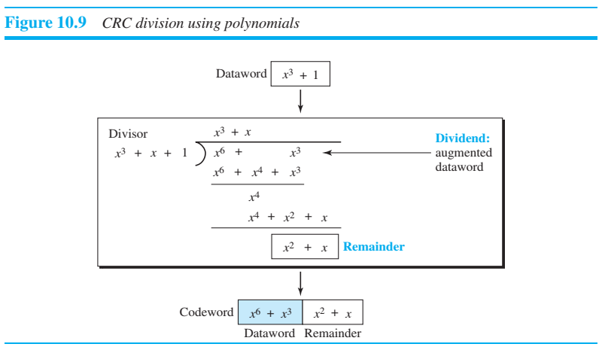
CRC division using polynomials

